Slide 1



Bi-Weekly Update 2
Team 32: Abhi Singh, Holden Haile, Kelton Chesshire Sponsor: Eric Lloyd Robles TA: Eric Lloyd Robles
Notes:
Michelle

Slide 2
Problem Statement
In the U.S. Alone over 10% of the population suffers from Diabetes. Type 1 diabetes can require a person to monitor their blood sugar level 4-10 times a day and intake carbohydrates if their blood sugar is low. This can become a guess and check game where the person is not able to consistently and accurately dose themselves, and can lead to detrimental effects on quality of life.

Slide 3
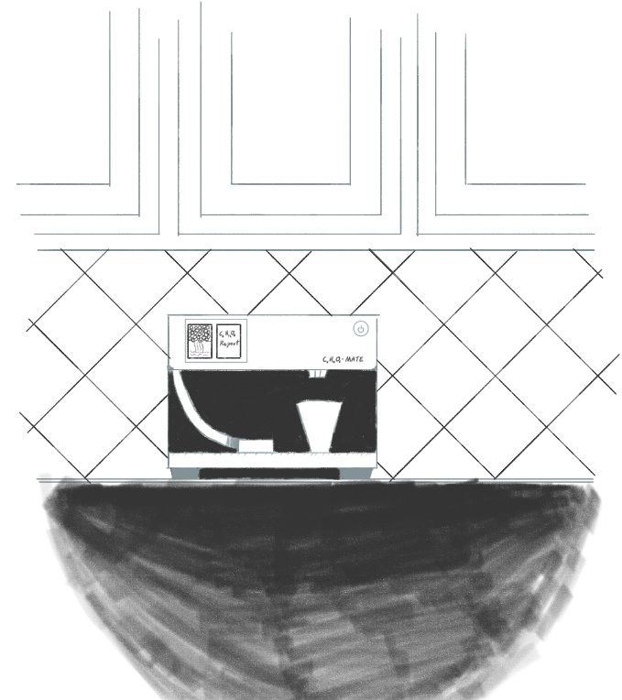
Solution Proposal
Our system will dispense carbohydrates in a consistent, accurate, and easily-consumable manner so that users have an easy way of maintaining a normal blood sugar level 24/7.

Slide 4
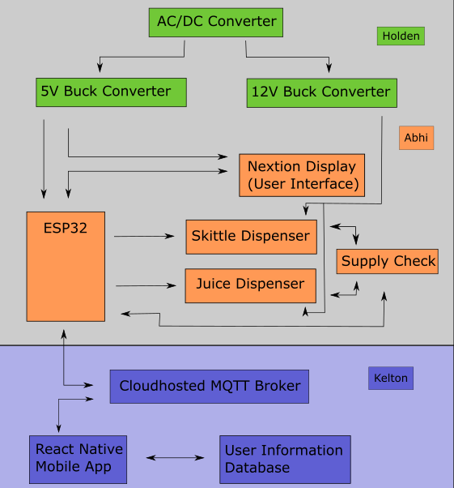
System Overview
Power Supply
Dispenser
Application

Slide 5
Subsystem Changes/Improvements since last week
Design Changes proposed to us by Dr. John Lusher and Subsystem Improvements that are being actively implemented
Dispenser: Tested Sensors, Planned Circuit Layout, Measured Dimensions for the enclosure CAD model
Power Supply: Swapping Voltage Regulators out and Downsizing Capacitors on Power Supply
Application: Status notifications, Glucose input
Notes:
Eric

Slide 6
Project Timeline
Last Week
Next 2 weeks
10/5
11/5
11/16
Discuss System Improvements
Subsystem Improvements
Major Project Design
Final Subsystem Integration
Preparation for Final Presentation & Demo
We focused on how to improve our subsystems from the good baseline from 403
Subsystem Improvements will be made and tested
Design Housing and PCBs for Power Supply and Dispenser, App integration with Health Apps, HMI control implemented
Dispenser and Power Supply will be installed in the housing, testing and validation of System: Dispenser powered with our Power Supply and Tested with Our App
Final Tweaks to subsystems if needed, polishing the product for presentation and testing user experience
Notes:
Eric

Slide 7
Power Supply
Holden Haile
Accomplishments since last presentation 10 hrs of effort | Ongoing progress/problems and plans until the next presentation
Re-designed circuit finished Components finalized and dimensions calculated | Testing of implemented re-design suggestions from Dr. Lusher Begin housing design dimensional outline

Slide 8
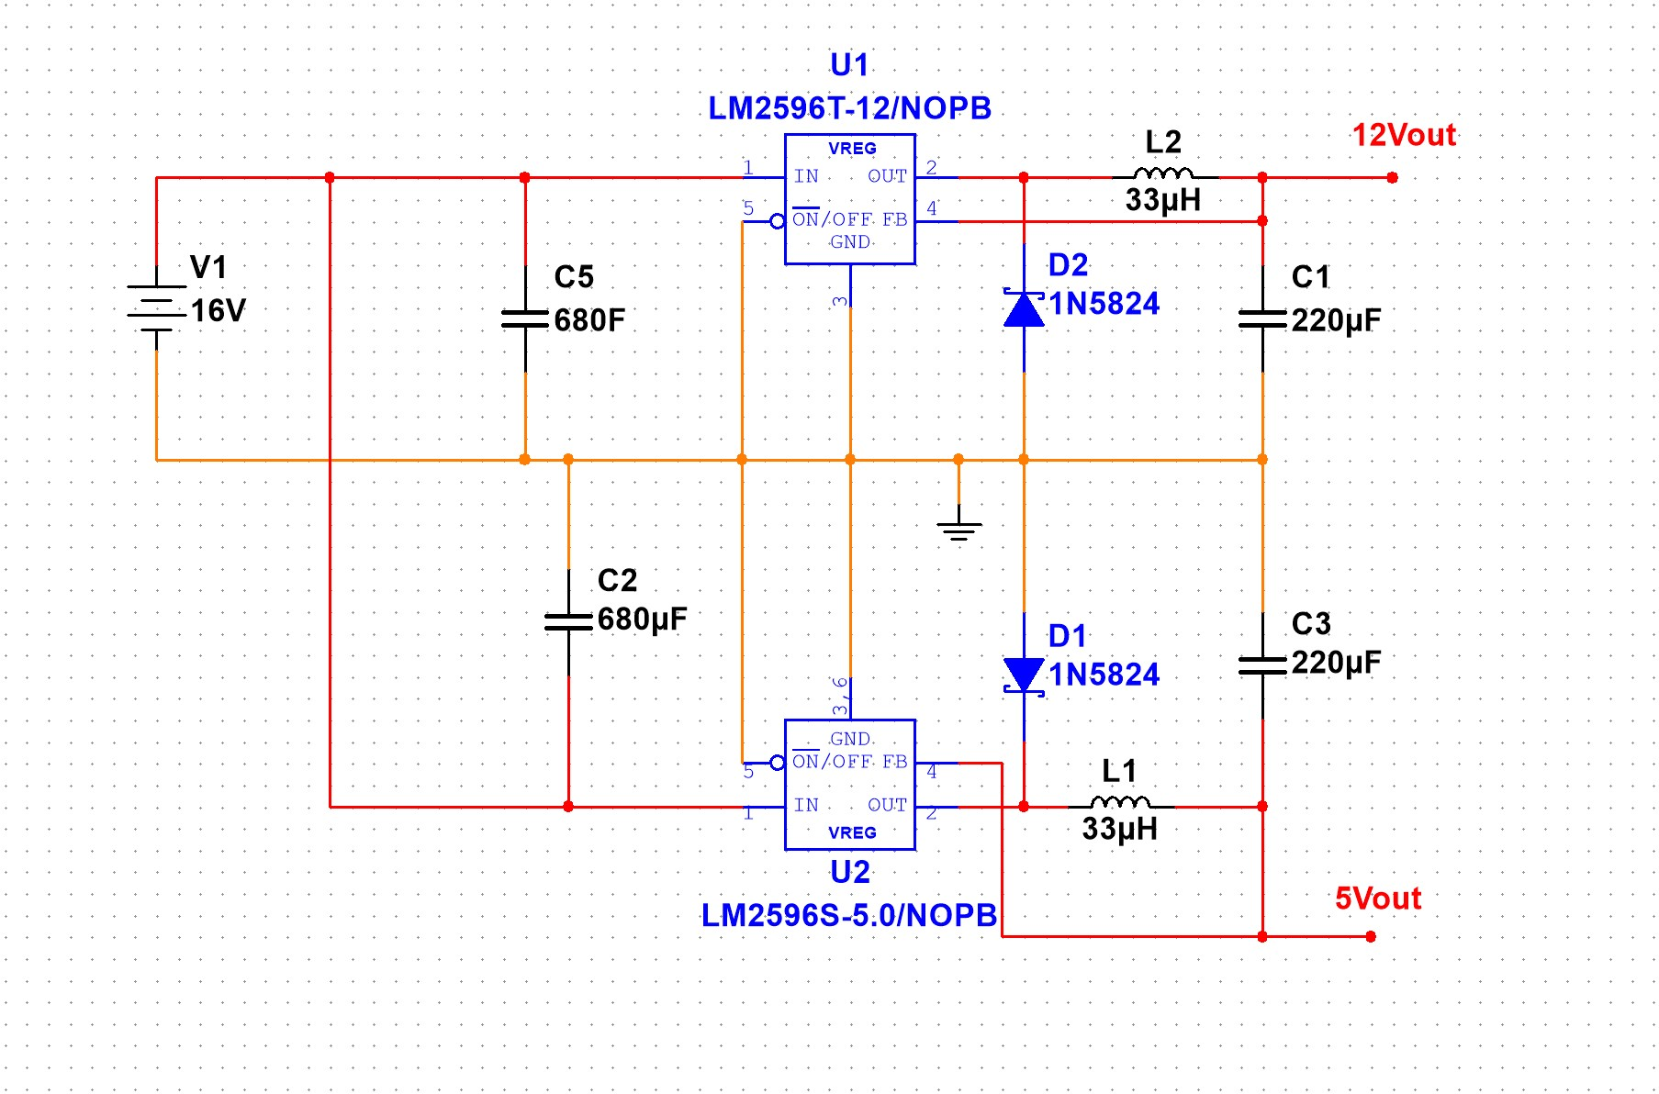
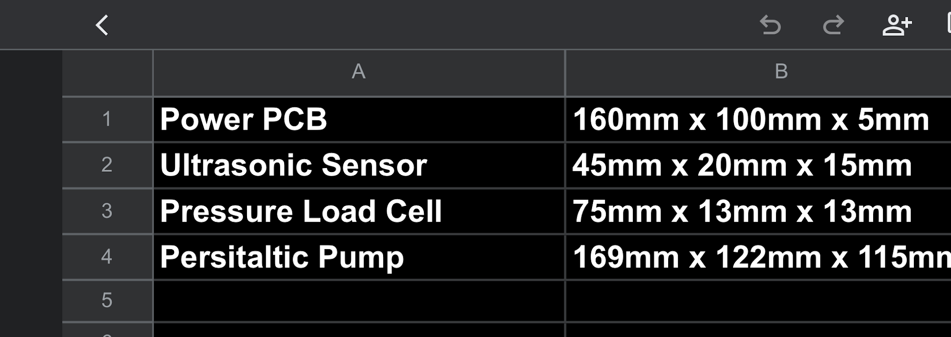
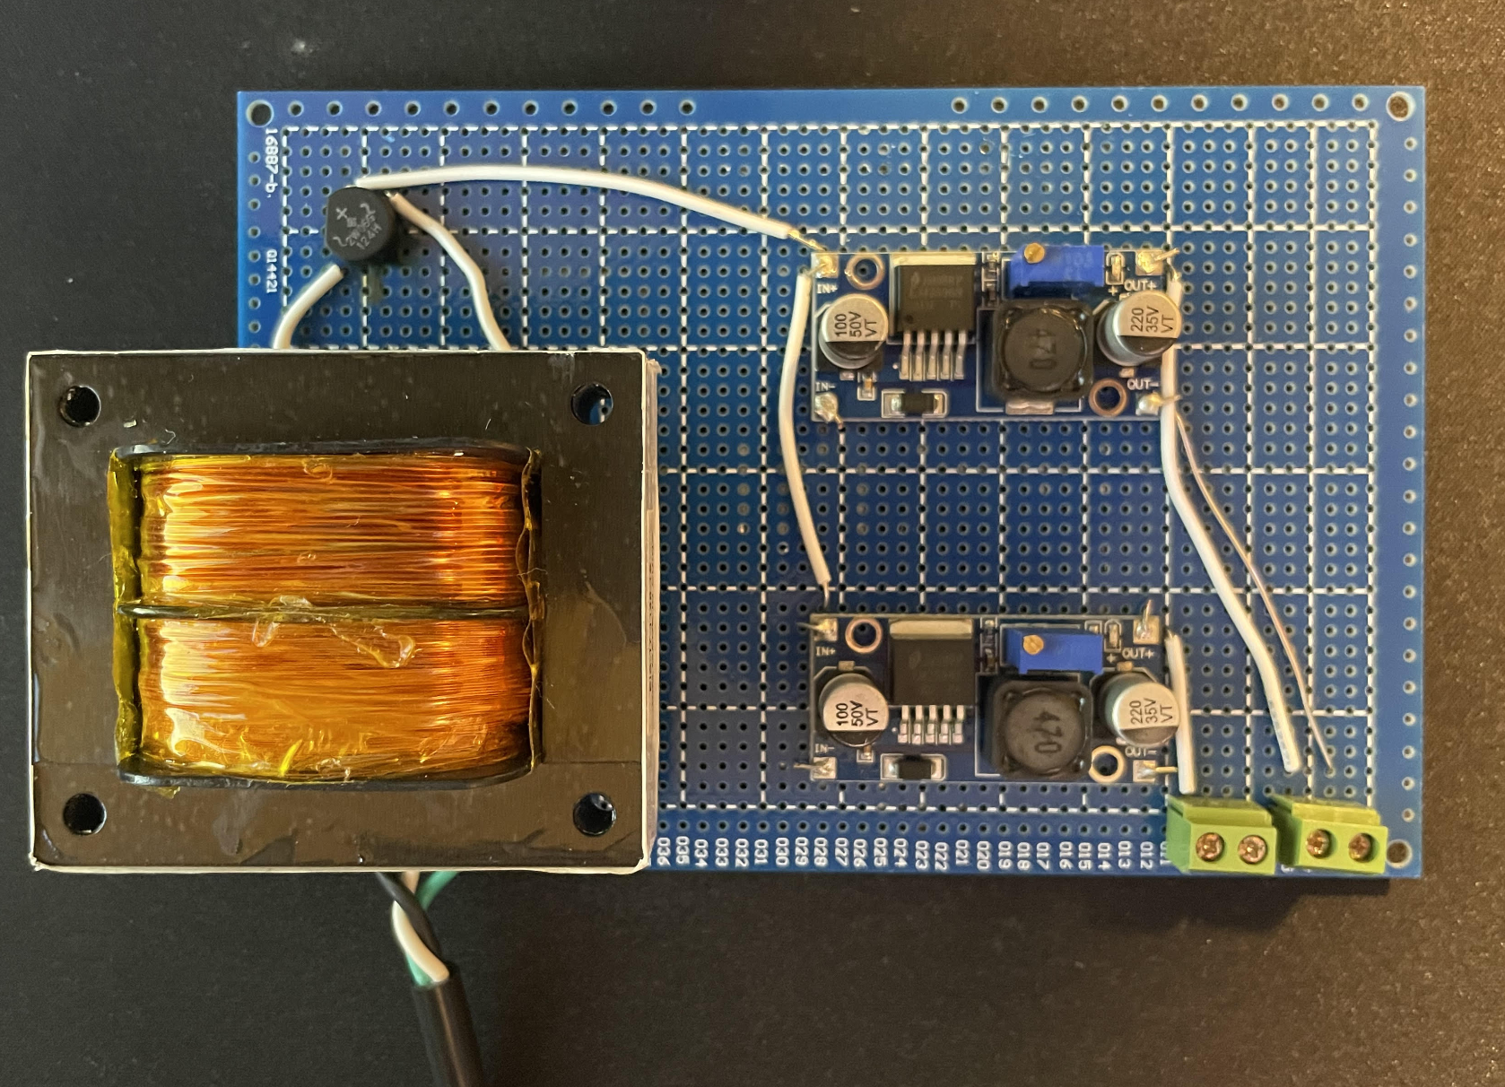
Power Supply
Holden Haile
Power supply soldered and ready for testing
Parts dimensions formatted in spreadsheet and prepared for our casing design this week

Slide 9
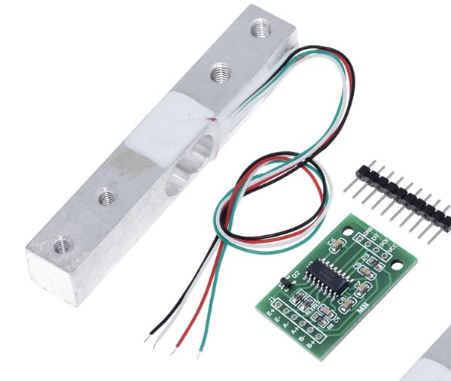
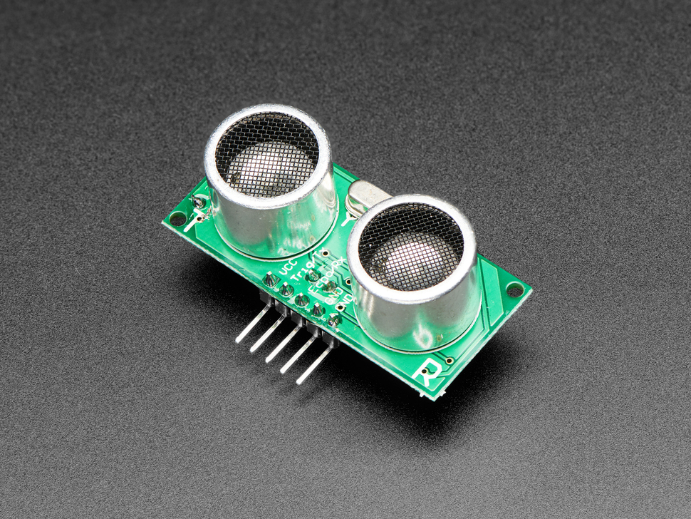
Dispenser
Abhi Singh
Accomplishments since Last Update 10 hrs | Ongoing progress/problems and plans until the next presentation
Tested and Verified Ultrasonic Sensor and Load Cell Sensor with ESP32 Completed Schematic of Dispenser Electronics (Ready to Design a simple PCB) | Test MOSFET circuit on breadboard Update Dispenser code using FreeRTOS, use OOP standards instead of just functions Design Housing for sensors

Slide 10
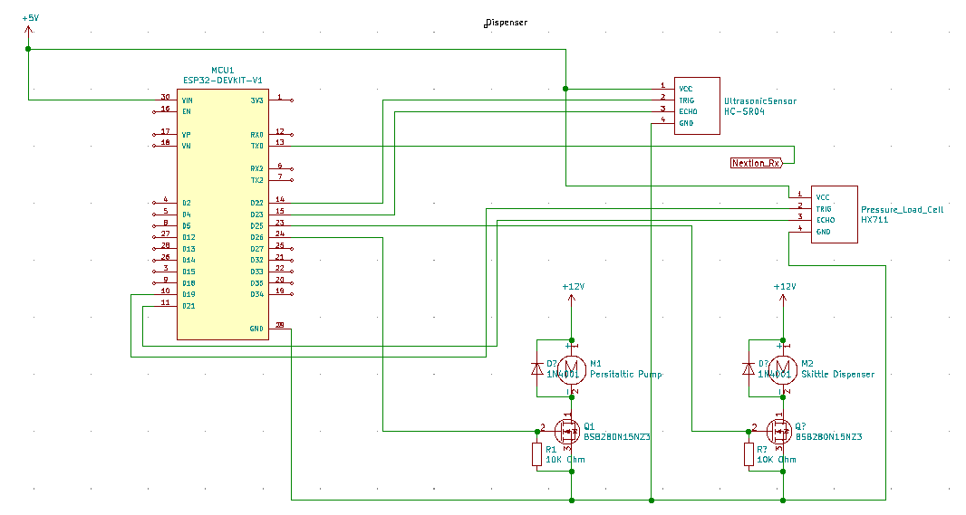
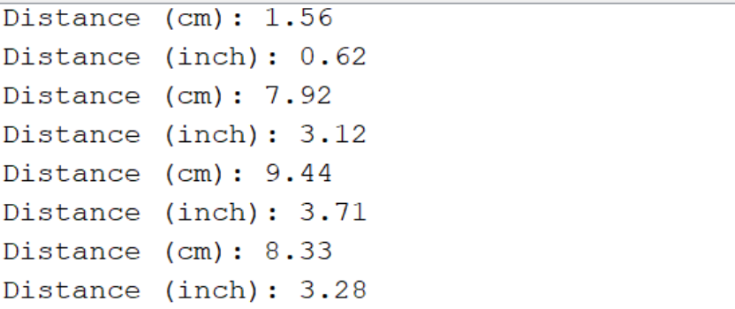
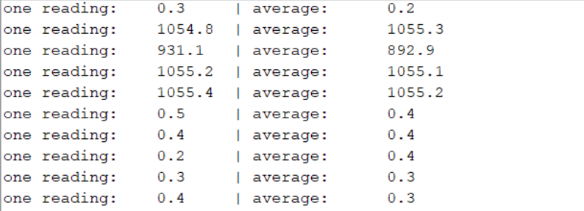
Dispenser
Abhi Singh

Slide 11
Application
Kelton Chesshire
Accomplishments since Last Update 12 hrs of effort | Ongoing progress/problems and plans until the next presentation
Dispenser Notifications Glucose Input System | BMI Information Work on Nextion Display with Abhi

Slide 12
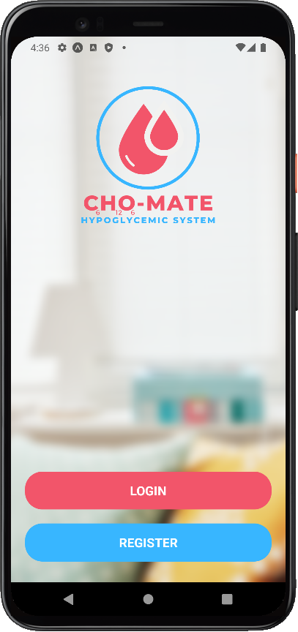
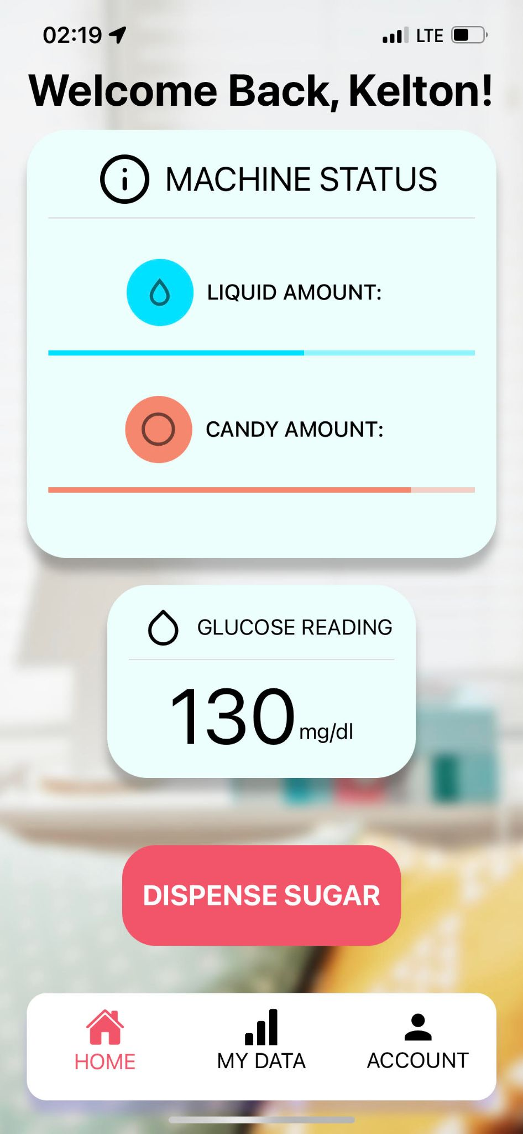
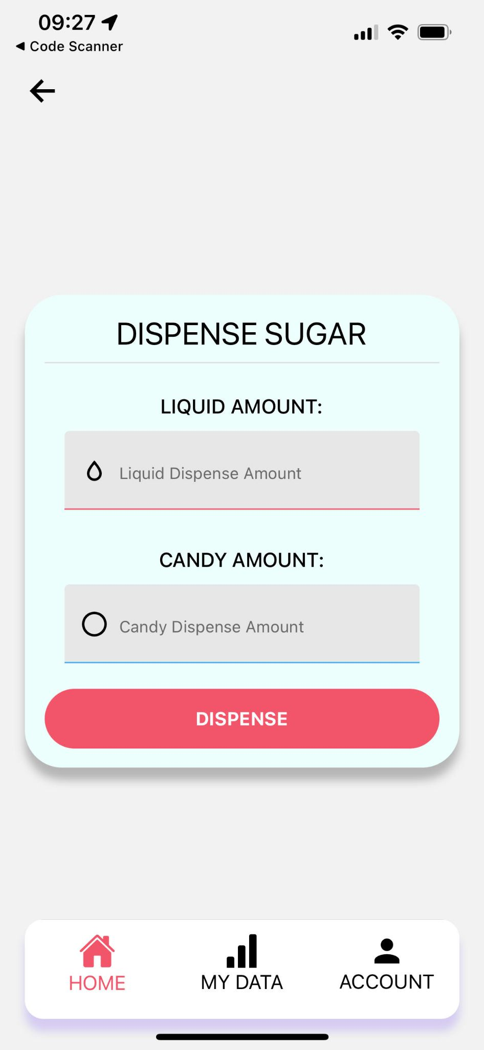
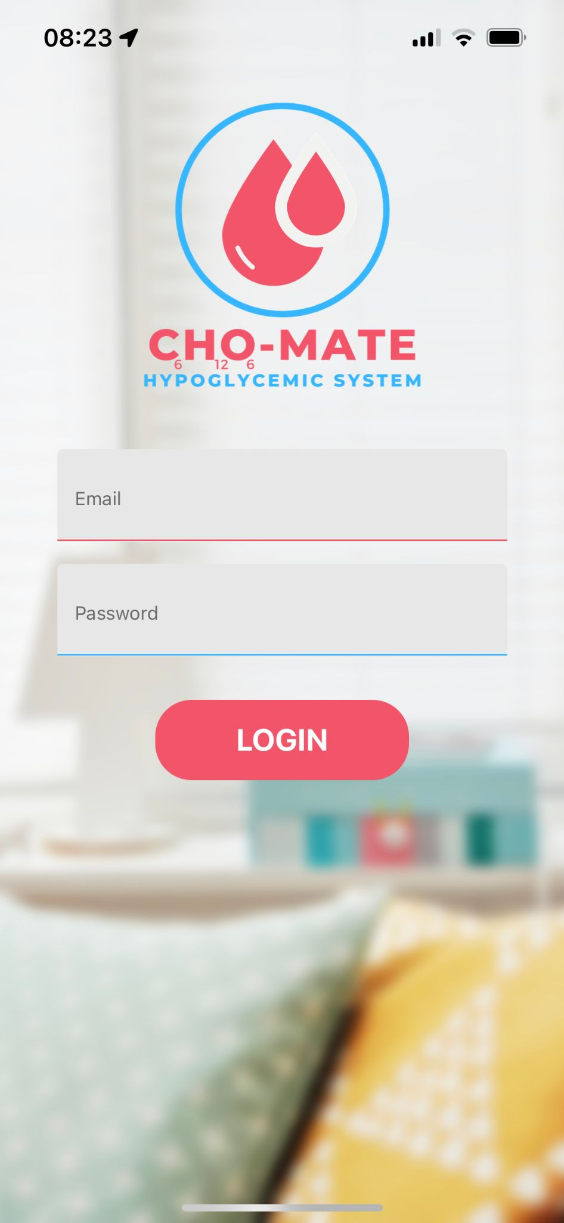
Application
Kelton Chesshire

Slide 13
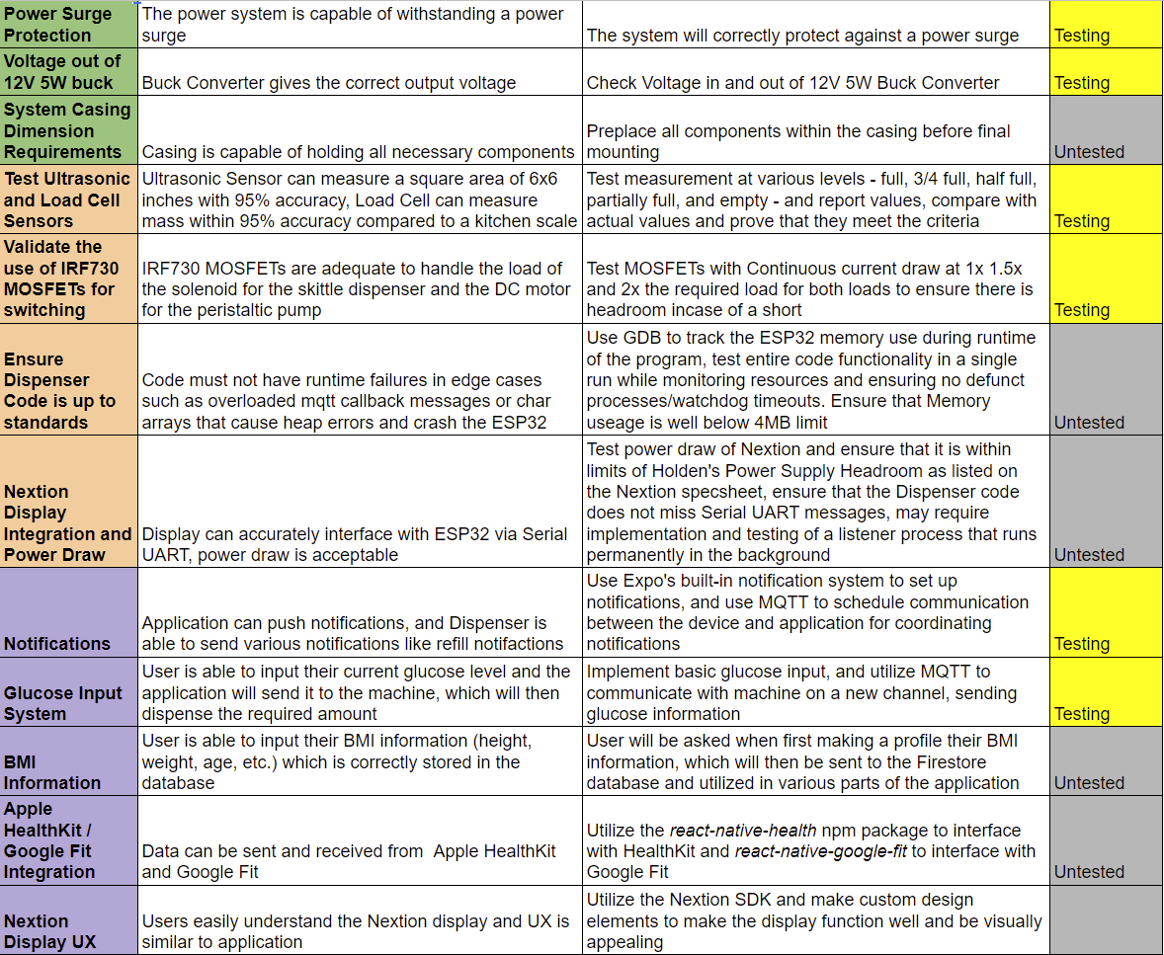
Validation Plan

Slide 14
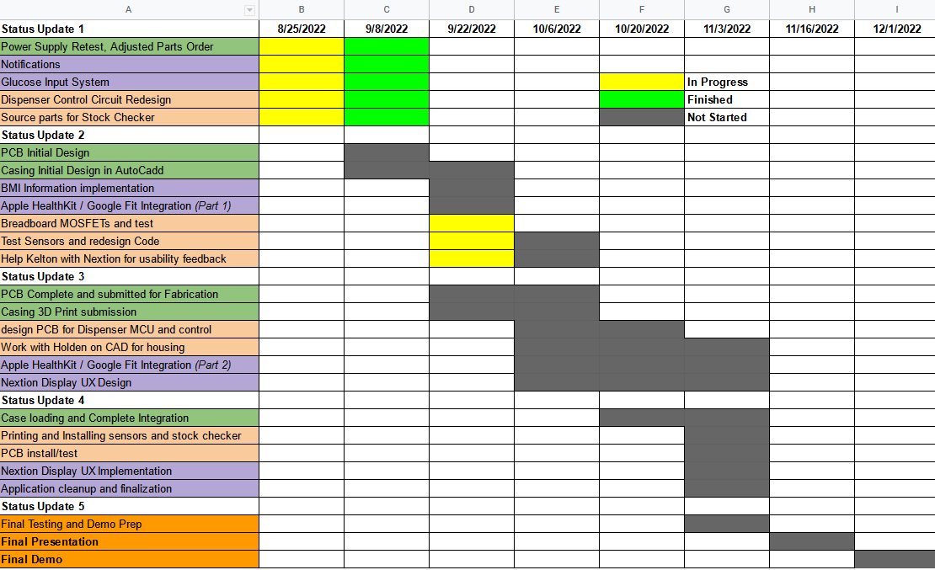
Execution Plan

Slide 15
Questions?

